Slide 1
Buddhism

Slide 2
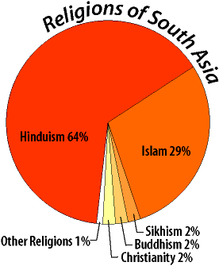
Religions of South Asia

Slide 3
The essence of Buddhism
The “middle way of wisdom and compassion.”
2,500 year old tradition.
The 3 jewels of Buddhism:
Buddha, the teacher.
Dharma, the teachings.
Sangha, the community.

Slide 4
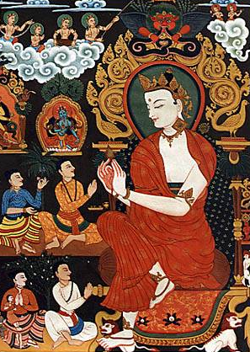
Siddhartha Gautama (563-483 BCE)
Born in NE India (Nepal).
Raised in great luxury to be a king.
At 29 he rejected his luxurious life to seek enlightenment and the source of suffering.
Lived a strict, ascetic life for 6 yrs.
Rejecting this extreme, sat in meditation, and found nirvana.
Became “The Enlightened One,” at 35.

Slide 5
What is the fundamental cause of all suffering?
Desire!
Therefore, extinguish the self, don’t obsess about oneself.

Slide 6
Four Noble Truths
There is suffering in the world. To live is to suffer. (Dukkha)
The Buddha found this out when he was young and experienced suffering and death in others.

Slide 7
Four Noble Truths
The cause of suffering is self-centered desire and attachments. (Tanha)

Slide 8
Four Noble Truths
The solution is to eliminate desire and attachments. (Nirvana = “extinction”)

Slide 9
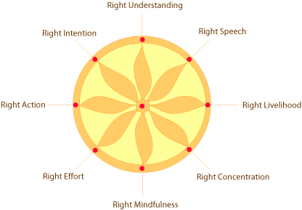
Four Noble Truths
To reach nirvana, one must follow the Eightfold Path.

Slide 10
Eightfold Path
Nirvana
The union with the ultimate spiritual reality.
Escape from the cycle of rebirth.

Slide 11
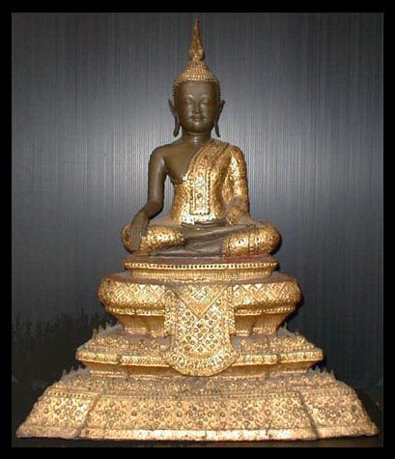
Buddha – 19c Thailand

Slide 12
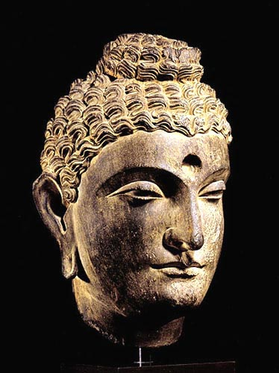
Buddha’s head :
2c Pakistan

Slide 13
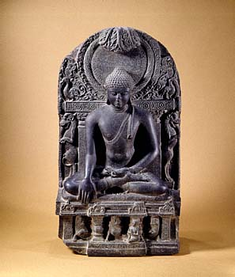
Buddhist Altar

Slide 14
Types of Buddhism
Therevada Buddhism
Mahayana Buddhism
Tibetan Buddhism
Zen Buddhism

Slide 15
Mahayana Buddhism
The “Great Vehicle.”
Founded in northern Asia (China, Japan).
Buddhism “for the masses.”
Seek guidance from Boddhisatvas, wise beings.
Goal: Not just individual escape from the wheel, but the salvation of all humanity through self-sacrifice of those enlightened few.

Slide 16
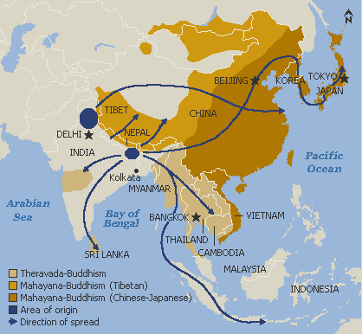
Mahayana Buddhism

Slide 17
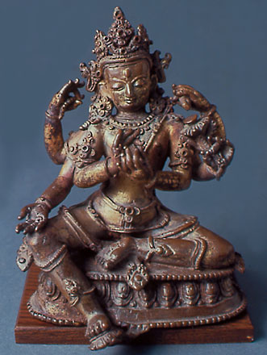
Seated Boddhisatva – 16c Bhutan

Slide 18
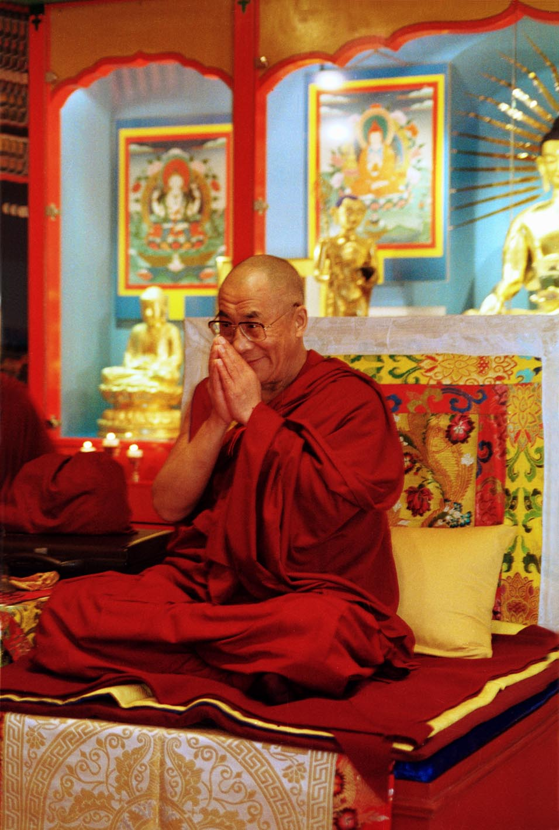
The Dalai Lama

Slide 19
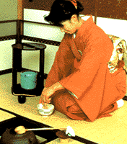
zen Buddhism
The “Meditation School.”
Seeks sudden enlightenment [satori] through meditation, arriving at emptiness [sunyata].
Use of meditation masters [Roshi].
Beauty, art, and aesthetics:
Gardens.
Archery.
Tea ceremony.
Calligraphy.

Slide 20
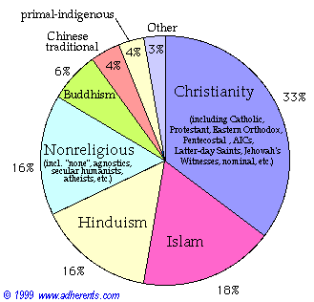
Buddhism in America (1999)

Slide 21
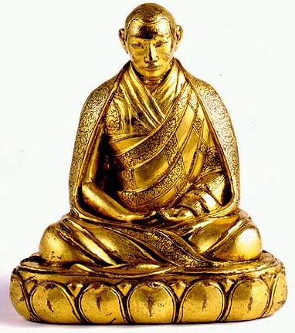
Relieve Stress & Meditate: Get a Mantra !
Ohm...mani...padme...hung...
Hail to the jewel in the lotus!

